Slide 1
Designing and Implementing a Data Warehouse

Slide 2
Agenda
Logical Design for a Data Warehouse
Physical Design for a Data Warehouse

Slide 3
Why build a DW/BI system?
The CIO told us to
I like to play with new technology
It’s a great opportunity to add business value
Great opportunity to work with Senior Management
We don’t want a DW/BI system, just one dashboard and three reports
I want to advanced my career

Slide 4
Risks of a DW/BI project
Failures (and successes) are high profile
Complicated
Data quality problems
Large stack
Excel PowerView PowerQuery PowerPivot SSAS SSIS SSRS Data Mining SQL Data Engine | DAX MDX T-SQL Design Patterns Performance PerformancePoint SharePoint Tabular/Multi-dimensional DQS/MDS

Slide 5
Driving a BI/DW Project
Not Technology Driven
  Business Driven
Iterative
Dimensional model for data delivery
Conformed Dimensions
Full solution from extracts to business value

Slide 6
Sample BI/DW Project Plan - Iterative
1) Find Executive Sponsor
2) Gather Requirements/
Define Vocabulary/
Wikidefinitions/
Requirements Document
3) Physical Design
4) Dimensional Modeling
5) ETL Development – 2/3rds start Report/Dashboard Development
6) Deployment/Training

Slide 7
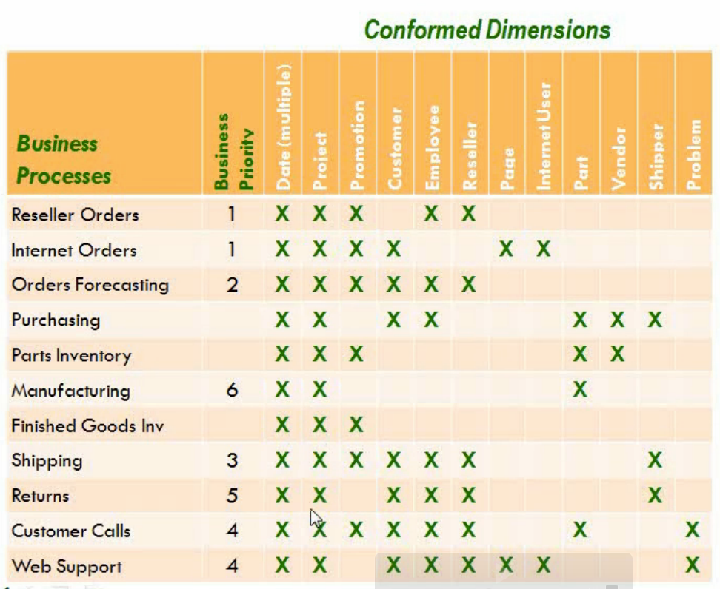
Create Document – Enterprise Bus Matrix

Slide 8
Introduction to Kimball Dimensional Modeling
Business questions focus on measures that are aggregated by business dimensions
Measures are facts about the business (nouns and strong words)
Dimensions are ways in which the measures can be aggregated:
  Pay attention to the “BY” keyword
  Examples:
    Sales revenue by salesperson
    Profit by product line
    Order quantity by Year
Product Line
Time
Quantity
Revenue
Profit
Salesperson

Slide 9
Star Schemas
Group related dimensions into dimension tables
Group related measures into fact tables
Relate fact tables to dimension tables by using foreign keys
DimSalesPerson
SalesPersonKey
SalesPersonName
StoreName
StoreCity
StoreRegion
DimCustomer
CustomerKey
CustomerName
City
Region
FactOrders
CustomerKey
SalesPersonKey
ProductKey
ShippingAgentKey
TimeKey
OrderNo
LineItemNo
Quantity
Revenue
Cost
Profit
DimDate
DateKey
Year
Quarter
Month
Day
DimProduct
ProductKey
ProductName
ProductLine
SupplierName
DimShippingAgent
ShippingAgentKey
ShippingAgentName
Notes:
Show Adventure Works Dimensions so they can see
Repeated data
Imagine Hierarchies

Slide 10
Considerations for Dimension Tables
Denormalization:
  Dimension tables are usually “wide”
  Duplicated values are usually preferable to joins
Keys:
  Create new surrogate keys to identify each row:
    Simple integer keys provide the best performance
  Retain original business keys
Conformed dimensions
  Dimensions that can be shared across multiple fact tables
DimSalesPerson
SalesPersonKey
EmployeeNo
SalesPersonName
StoreName
StoreCity
StoreRegion
Surrogate key
Business key
Denormalized (no separate Store table)

Slide 11
Considerations for Fact Tables
Grain:
  Use the lowest level of detail that relates to all dimensions
  Create multiple fact tables if multiple grains are required
Keys:
  The primary key is usually a composite key that includes dimension foreign keys
Measures:
  Additive: Measures that can be aggregated across all dimensions
  Nonadditive: Measures that cannot be aggregated
  Semi-additive: Measures that can be aggregated across some dimensions, but not others
Degenerate dimensions:
  Dimensions in the fact table
Grain =
Order Line Item
FactOrders
CustomerKey
SalesPersonKey
ProductKey
Timekey
OrderNo
LineItemNo
PaymentMethod
Quantity
Revenue
Cost
Profit
Margin
Degenerate Dimensions
Additive
Nonadditive
Semi-additive
FactAccountTransaction
CustomerKey
BranchKey
AccountTypeKey
AccountNo
CreditDebitAmount
AccountBalance

Slide 12
Snowflake Schemas
Normalized dimension tables
DimSalesPerson
SalesPersonKey
SalesPersonName
StoreKey
Consider when:
  A subdimension can be shared between multiple dimensions
  A hierarchy exists, and the dimension table contains a small subset of data that may be changed frequently
  A sparse dimension has several different subtypes
  Multiple fact tables of varying grain reference different levels in the dimension hierarchy
DimStore
StoreKey
StoreName
GeographyKey
DimDate
DateKey
Year
Quarter
Month
Day
FactOrders
CustomerKey
SalesPersonKey
ProductKey
ShippingAgentKey
TimeKey
OrderNo
LineItemNo
Quantity
Revenue
Cost
Profit
DimGeography
GeographyKey
City
Region
DimCustomer
CustomerKey
CustomerName
GeographyKey
DimShippingAgent
ShippingAgentKey
ShippingAgentName
DimProductLine
ProductLineKey
ProductLineName
DimProduct
ProductKey
ProductName
ProductLineKey
SupplierKey
DimSupplier
SupplierKey
SupplierName

Slide 13
Time Dimensions
Enable consistent granularity for temporal analysis and reporting
Usually contain temporal hierarchies:
  For example, Year > Quarter > Month > Day
Can contain business-specific attributes:
  For example, public holidays and fiscal periods
Can be populated in many ways:
  Transact-SQL scripts using Date/Time functions
  Microsoft Excel functions
  Autogeneration by BI tools

Slide 14
Physical Data Placement
Distribute data across physical devices:
  Use a combination of filegroups and RAID storage
Beware TempDB Pressure
Separate log files from data files
Separate workspace objects from data:
  For example, temporary staging tables
Preallocate space and disable autogrow

Slide 15
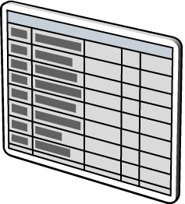
Indexing
Dimension table indexes:
  Nonclustered primary key index
  Clustered business key index
  Nonclustered indexes on frequently searched columns
Fact table indexes:
  Clustered index on most queried time dimension key
  Nonclustered indexes on frequently searched dimension keys
  SQL Server query optimizer includes enhanced semantics for star join queries
Columnstore indexes:
  Create columnstore indexes on fact tables
  Also consider them for large dimension tables
  be aware of the following considerations:
    Only define one columnstore index per table.
    Columnstore indexes are read-only…be prepared to drop for new or updated data.
    Columnstore indexes on a partitioned table must be partition aligned.
    The base object for a columnstore index is always a table, never a view

Slide 16
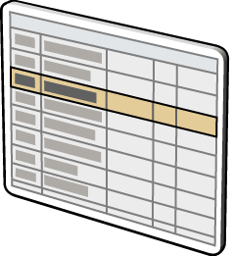
Partitioning
Partition large fact tables:
  Typically on a date key
Gain from several benefits:
  Improved query performance through partitioned table parallelism
  Faster data loading and deletion
  Improved index manageability
  Increased backup and restore flexibility
Use partition-aligned indexed views:
  Indexed views or summary aggregates are aligned with table partitions
Demo
Pre-Jan
Jan–Jun
Jul–Dec

Slide 17
Data Compression
Reduces physical space requirements
Can improve I/O-bound query performance
Typically 20–30 percent overhead on CPU-bound queries
Available in two forms:
  Row compression. Stores fixed-length columns as variable-length columns
  Page compression. Stores a single instance of redundant data on a page
Can be enabled per:
  Table
  Index
  Partition
Compress really big fact tables
Pre-Jan
(Page)
Jan–Jun
(Row)
Jul–Dec
(None)

Slide 18
LAB: Implementing a Data Warehouse Schema
Implementing a Star Schema
Implementing a Snowflake Schema
Implementing a Time Dimension Table
Estimated time: 45 minutes

